Slide 1
Web Appraisal Sprint 4
Josh Basar, Alec Breslow, Kimberly Nguyen, Matthew Peace, Brent Schapman, Brian Shuryan

Slide 2
Pre-sprint goals
Populate home page with actual data
Work on individual appraisal detail pages and forms
Mobile UI Optimization

Slide 3
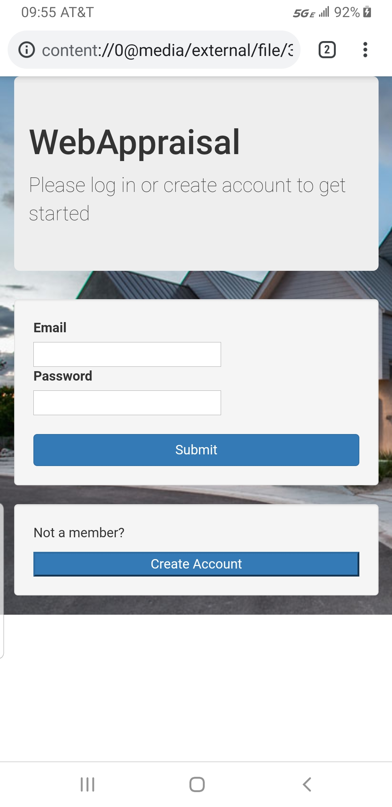
Where are we now?
Began testing and coding for mobile UI responsiveness
Finished our ERD for database structure/design
Started creating various forms needed for appraisal completion
Finished the following pages:
General appraisal/house information
Property Information
Description of Improvements
Neighborhood Information
Site Information

Slide 4
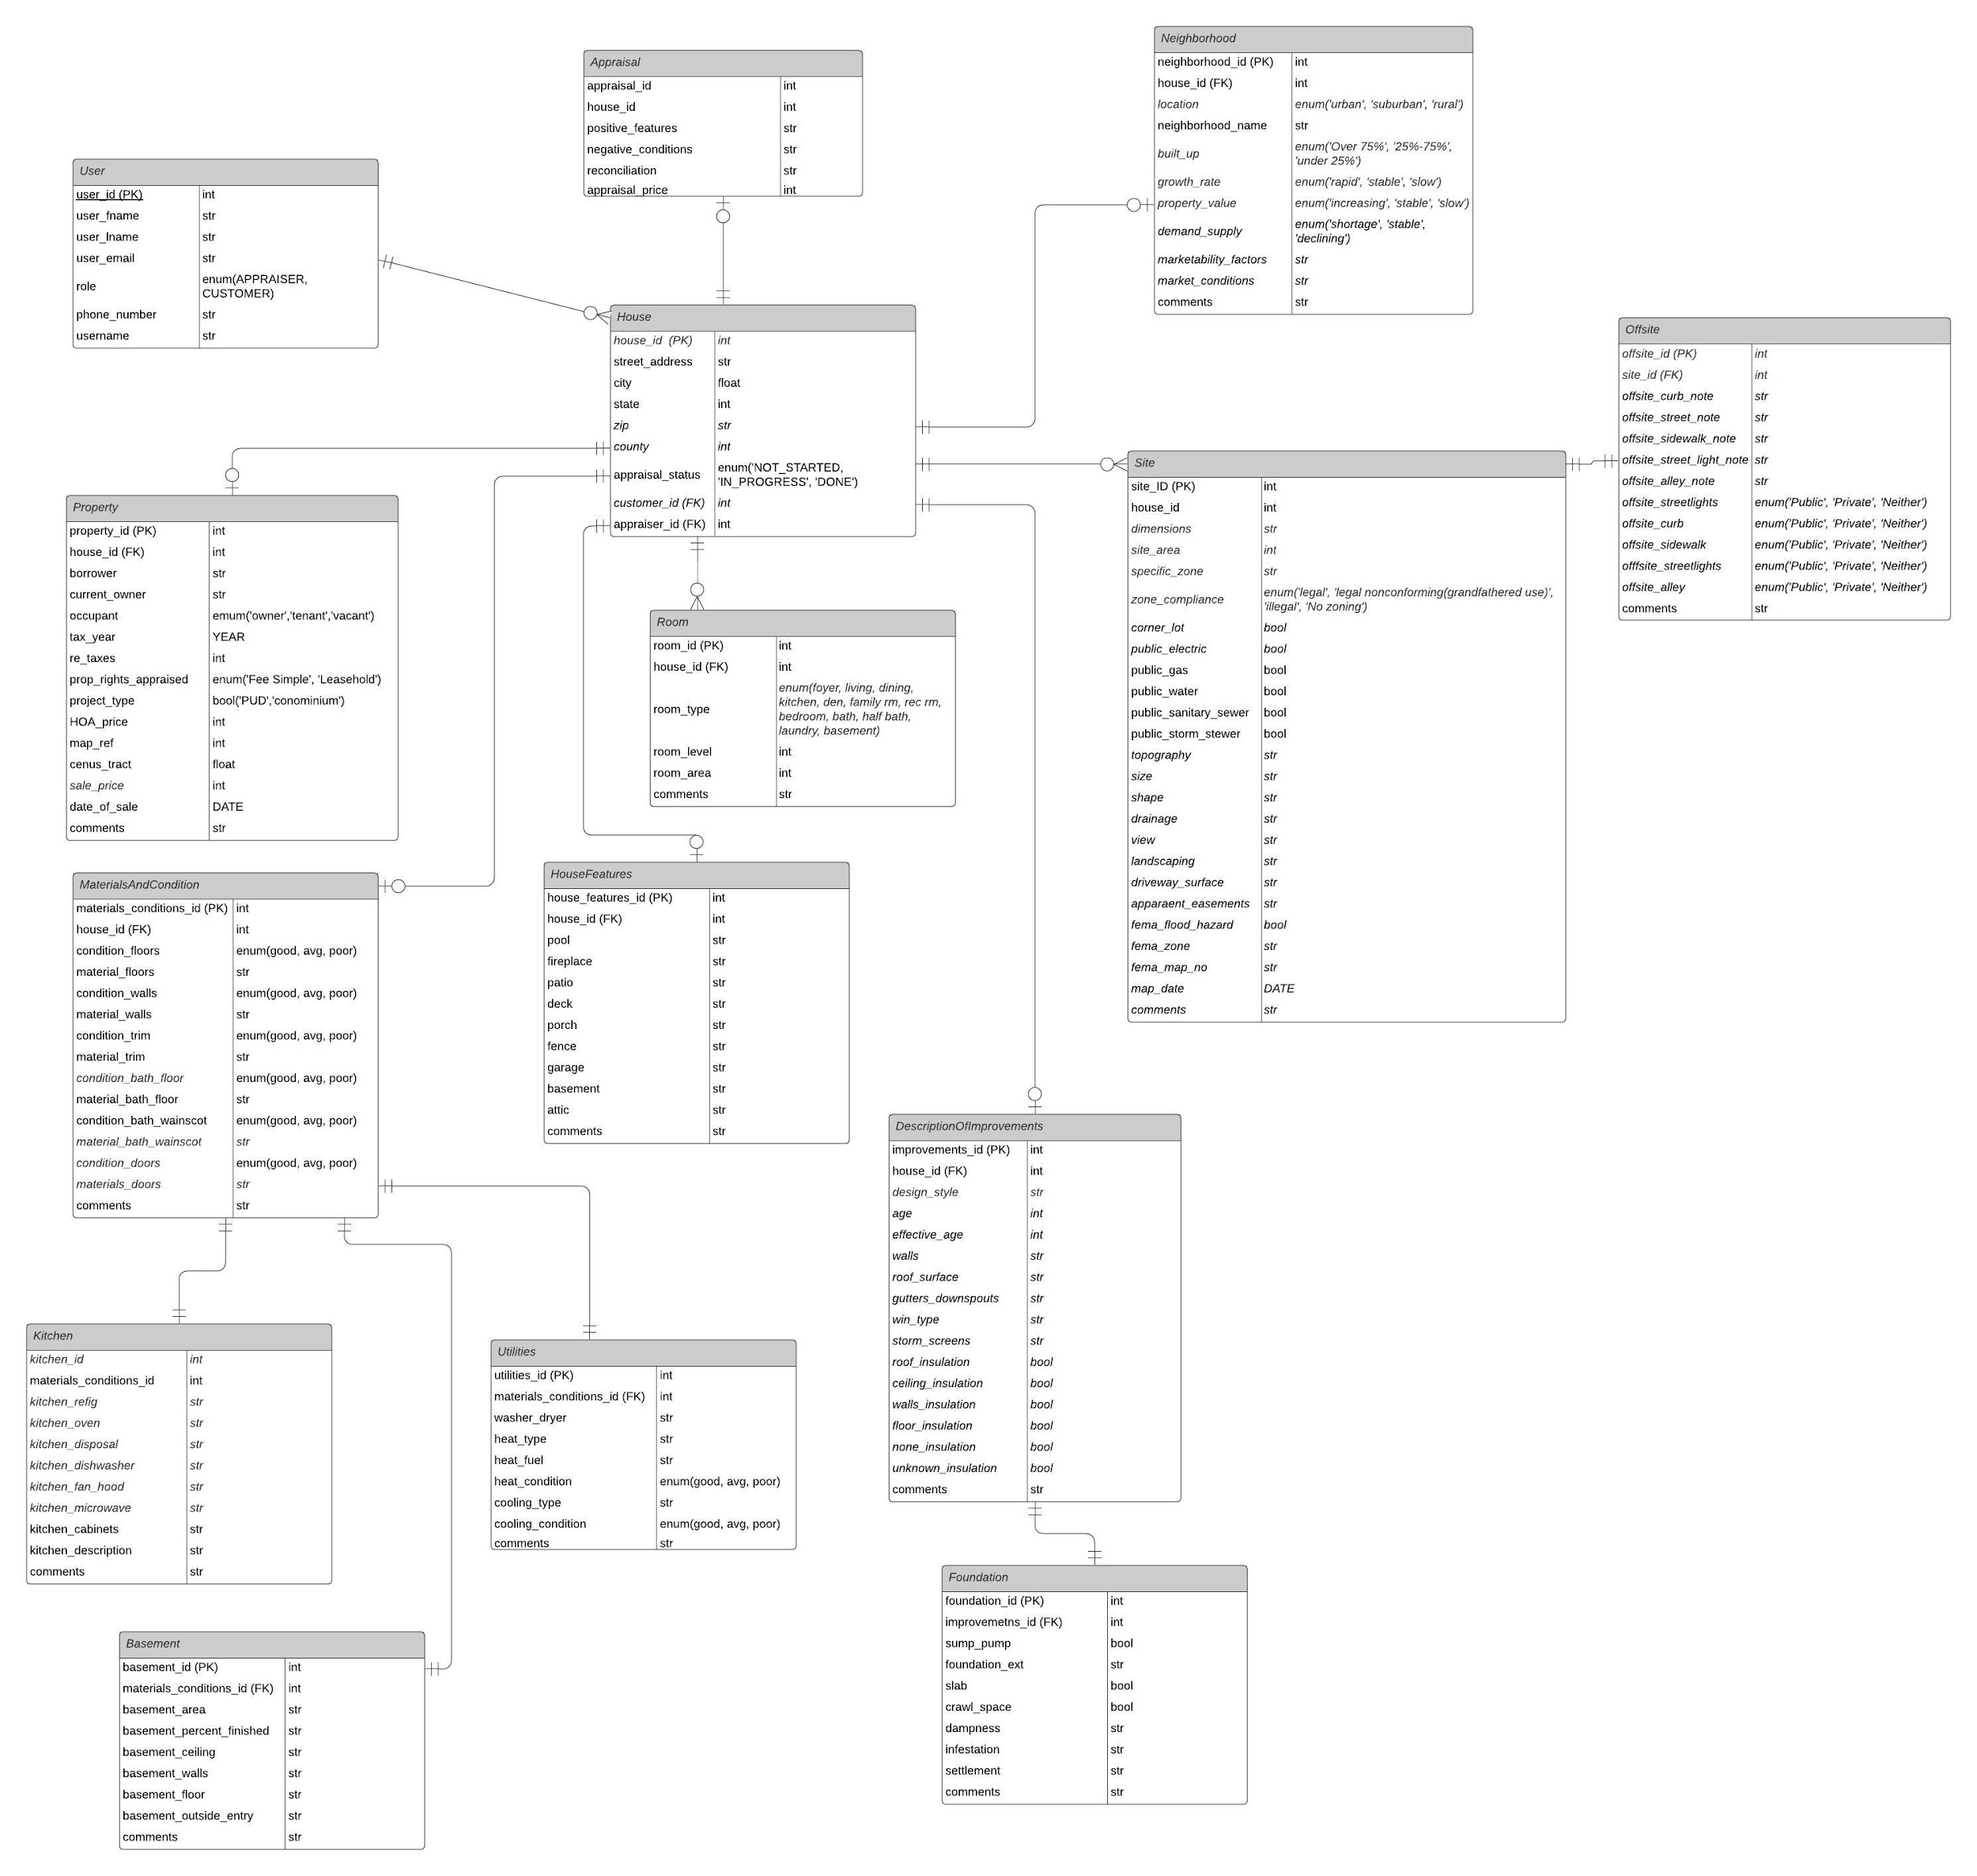
ERD Diagram

Slide 5
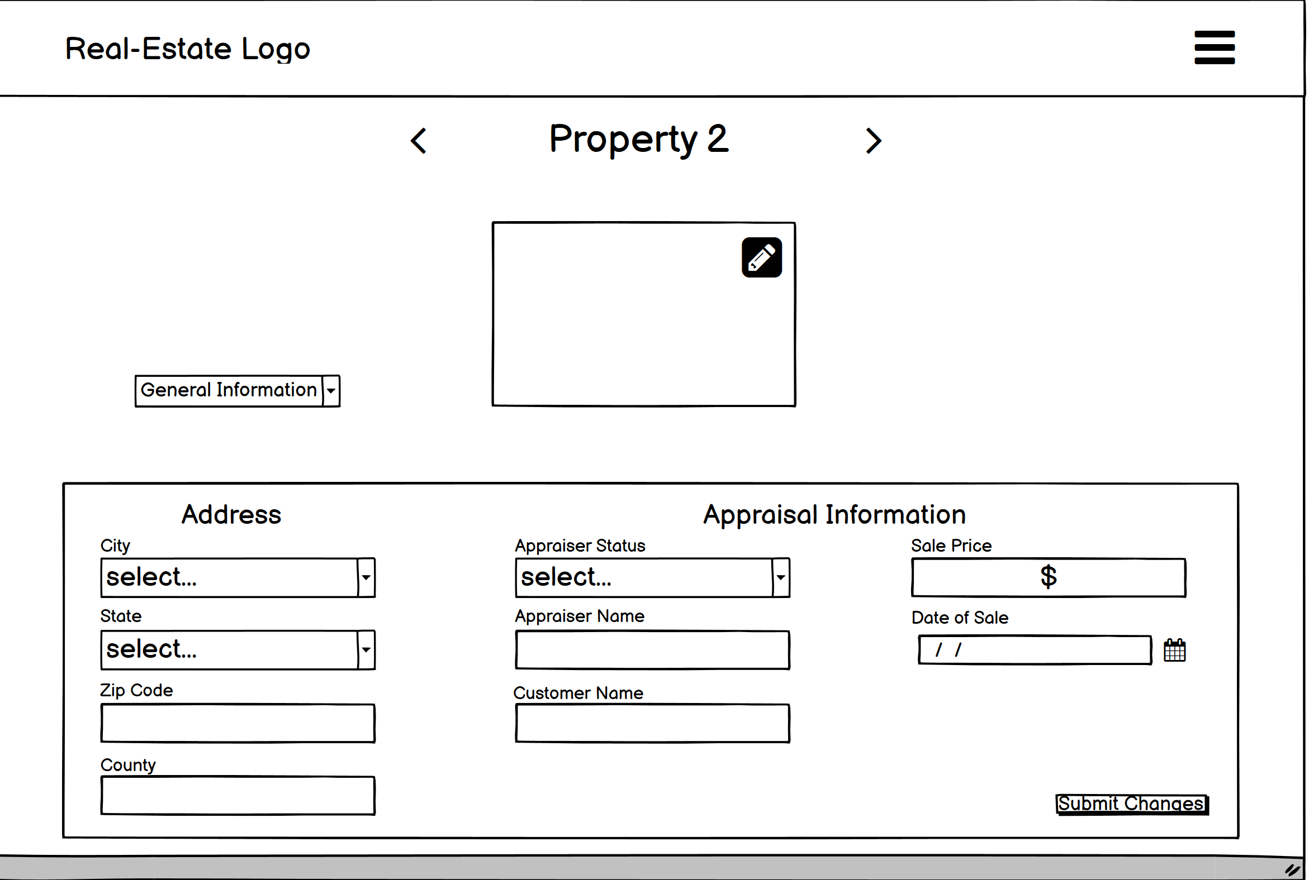
UI Mocks
General Information

Slide 6
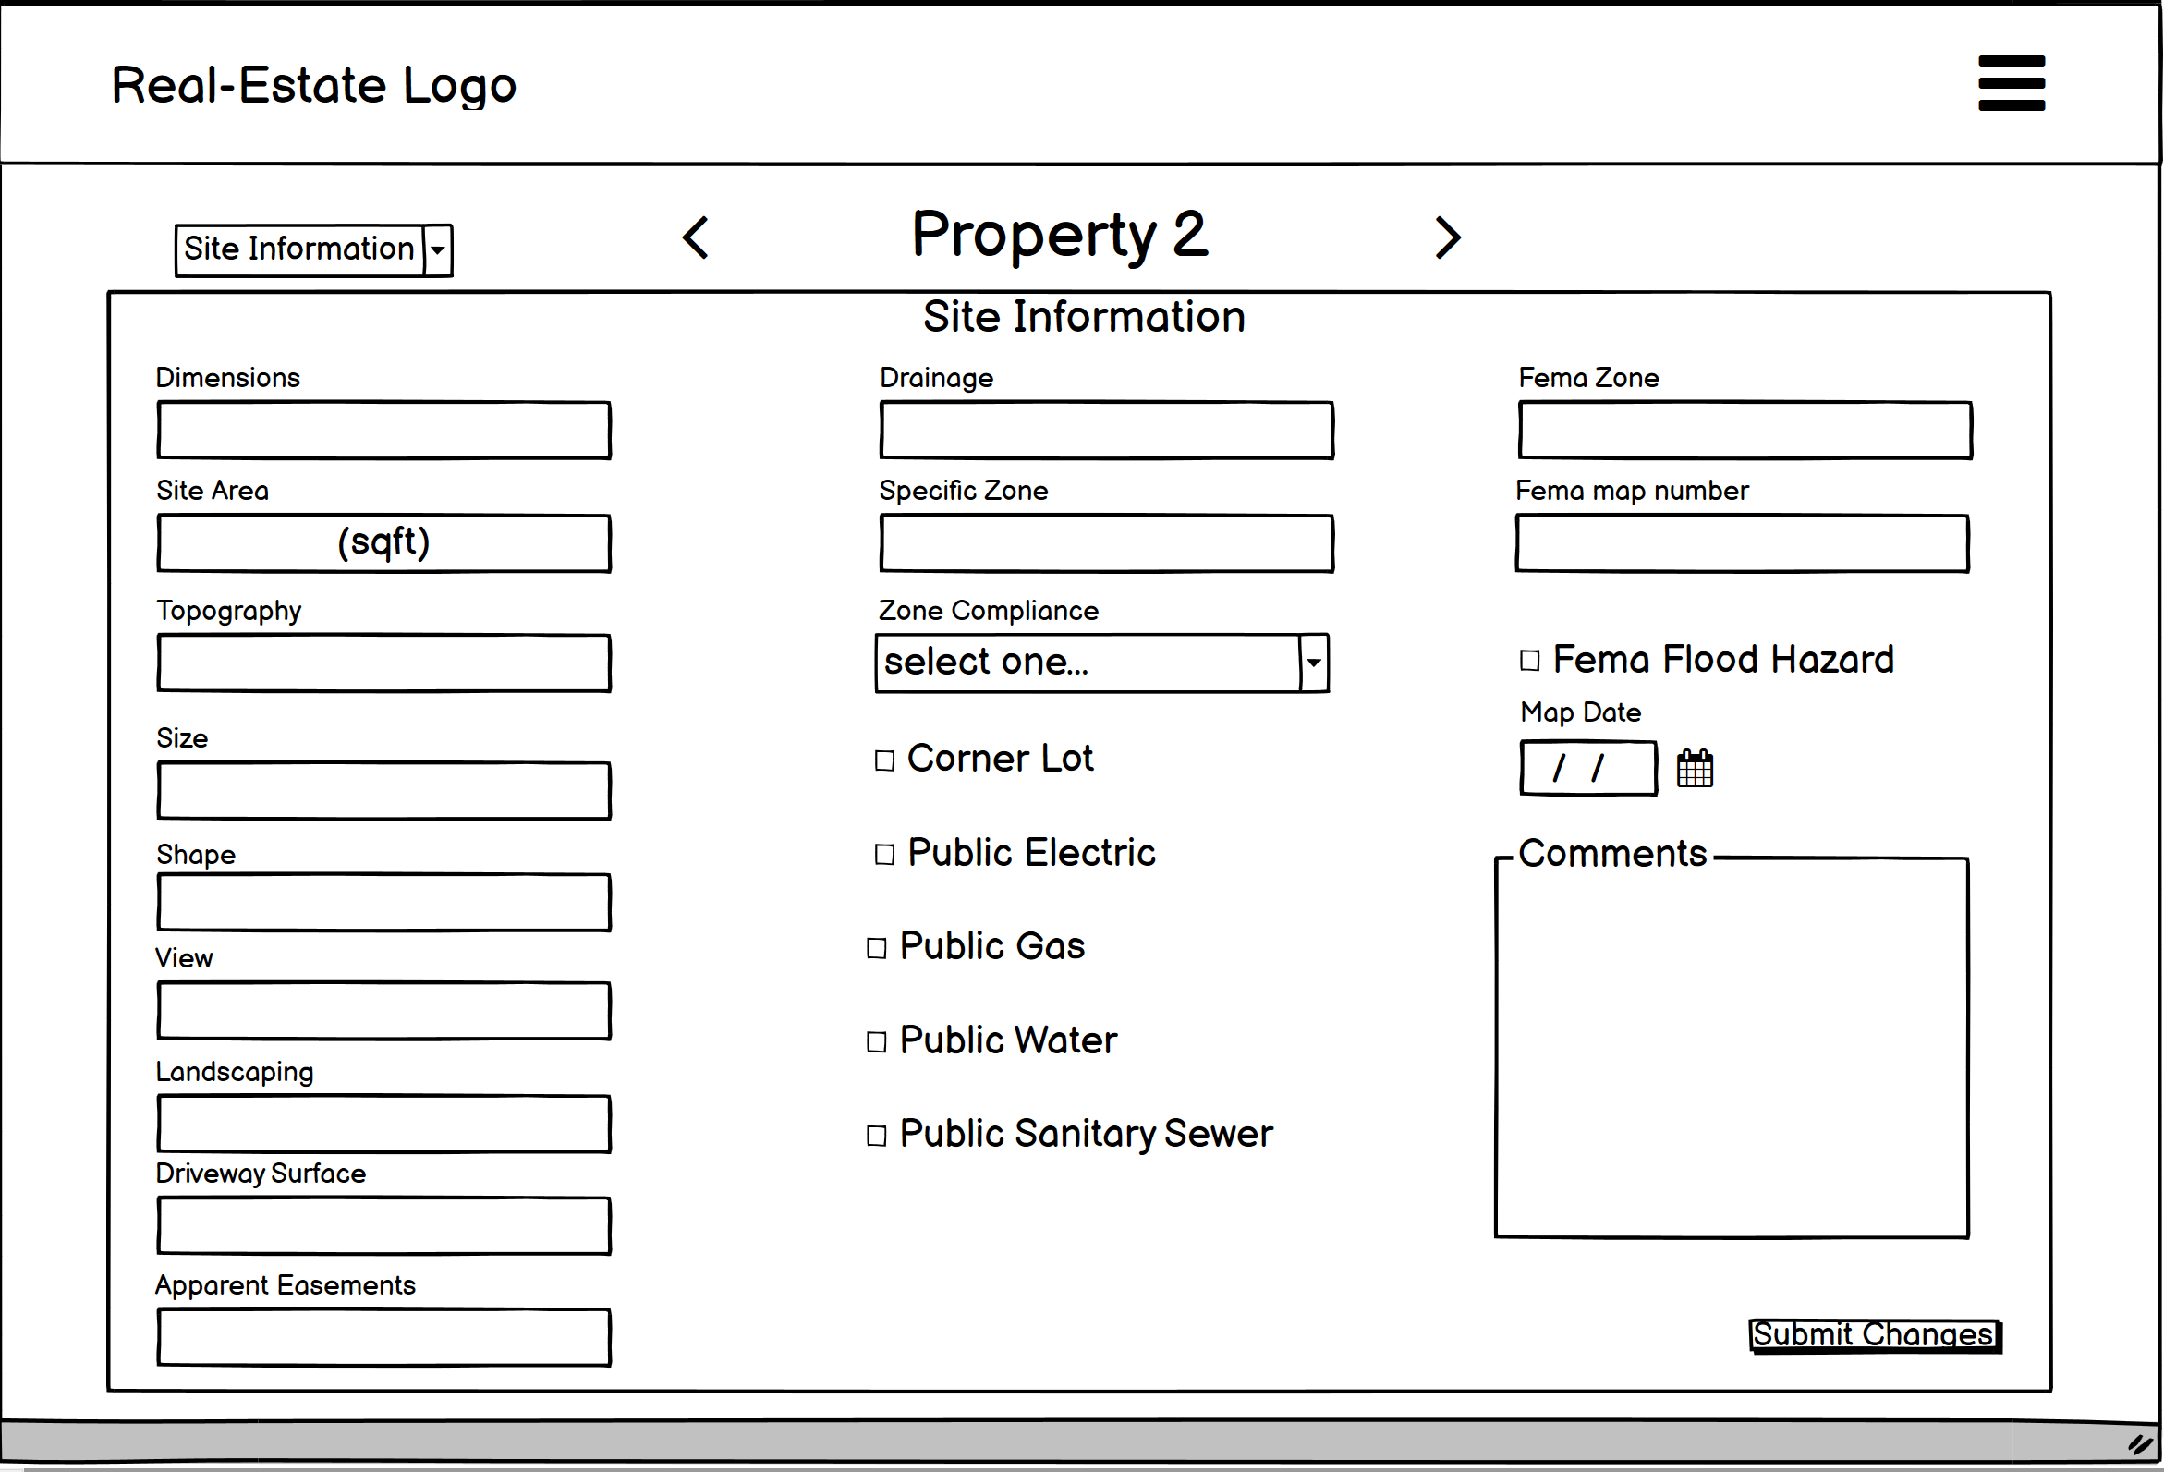
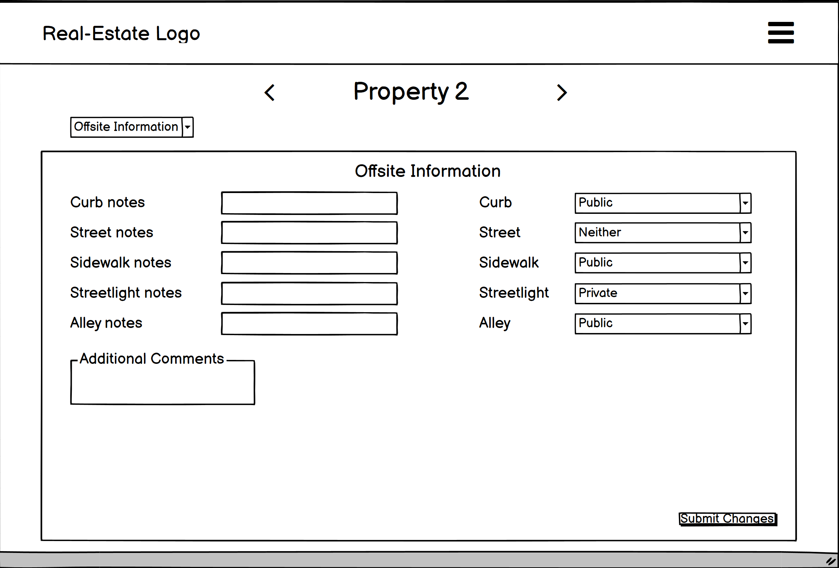
UI Mocks
Site Information

Slide 7
Sprint Challenges
We found that the appraisal data input was even more in-depth than we anticipated
Needed to spend more time in database design than expected
Originally had 6 appraisal pages planned, but soon found double that number is needed
Formatting our HTML/bootstrap forms for the appraisal pages
Different versions of bootstrap on different pages caused some time to be wasted

Slide 8
Demo!!

Slide 9
Next Sprint Objectives
Add tables in database and begin populating with actual data
Create the rest of the appraisal forms so an appraiser can go through the entire appraisal process and enter data
Finish this milestone end-to-end, complete with proper testing

